Slide 1
CSC 521
Advanced OO Programming with Java and Python
Project by:
1.Savita Khadse (SID-27565948)
WORDLE
2.Samee Peerzade (SID-59638609)
3.Sagar Tandel (SID-17857240)

Slide 2

Project Supervisor - Professor Da Qi Ren

Slide 3
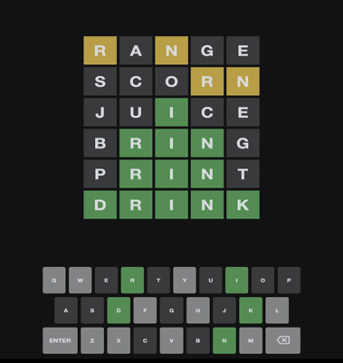
Wordle game introduction
What Is Wordle and How to Play?
“Wordle” is a game where the player tries to guess a dictionary word based on the hints that will be provided to the player in Wordle.
Once the player start guessing the word, the input letters will be reflected as yellow,gray or green tiles after user click submit. For example, a green tile means that the player predicted the correct placement of a letter in the correct word. A yellow tile means that the letter is present in the correct word, but the letter is in the wrong position. The gray tile means a letter does not exist in the correct word.
We have also added a function for user to play this game for multiple times till he logs out.

Slide 4
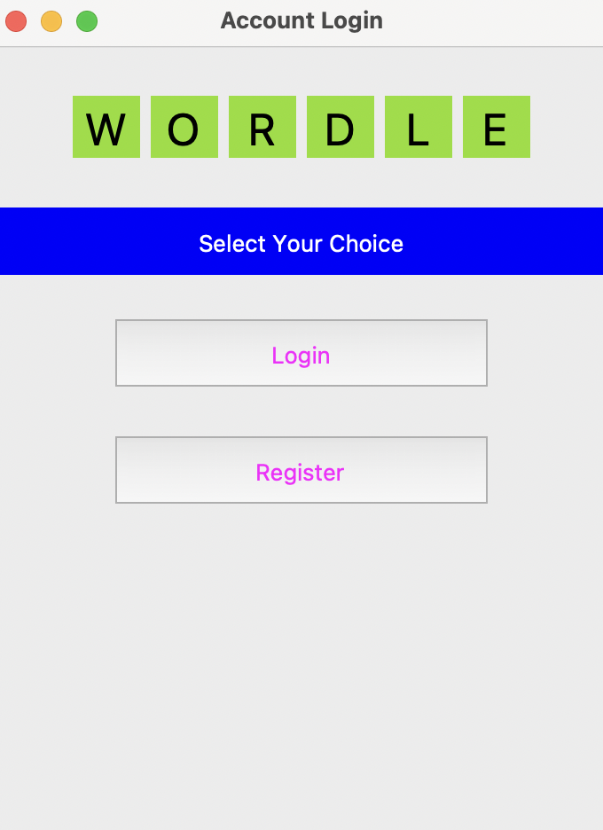
Register/ Login
Select your choice:
New User:
Click Register
Enter Username, password
And email-id

Slide 5
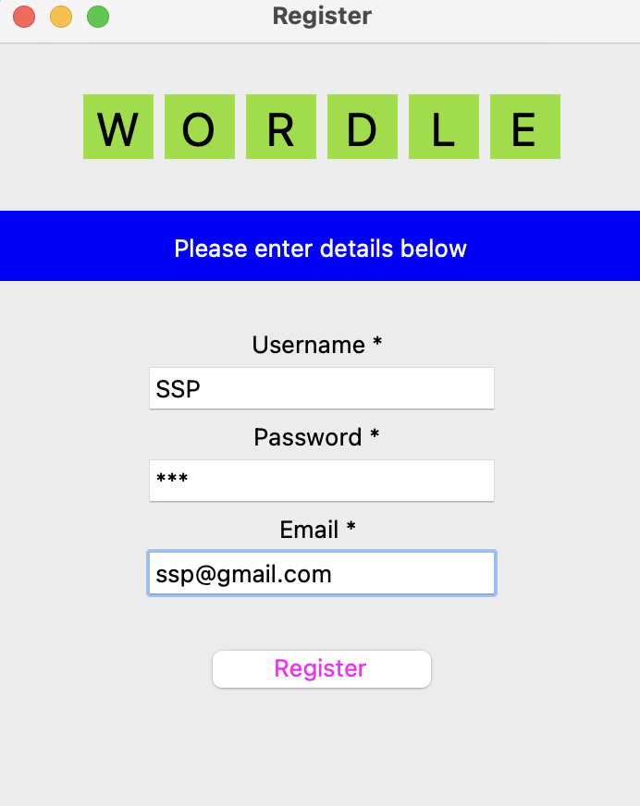
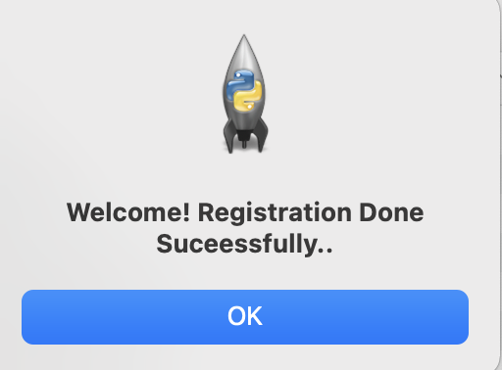
Registration process
Message after successful registration and entry in users table
Click register
Execute “select * from users;” in MySQL

Slide 6
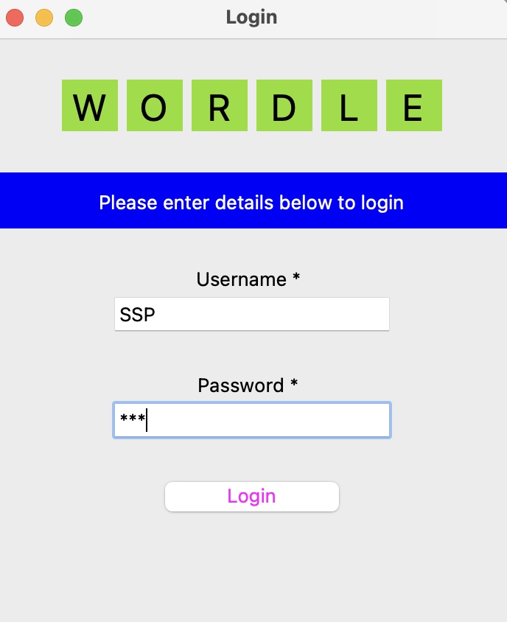
Login with registered username and password
Click Login
Enter registered username and password here

Slide 7
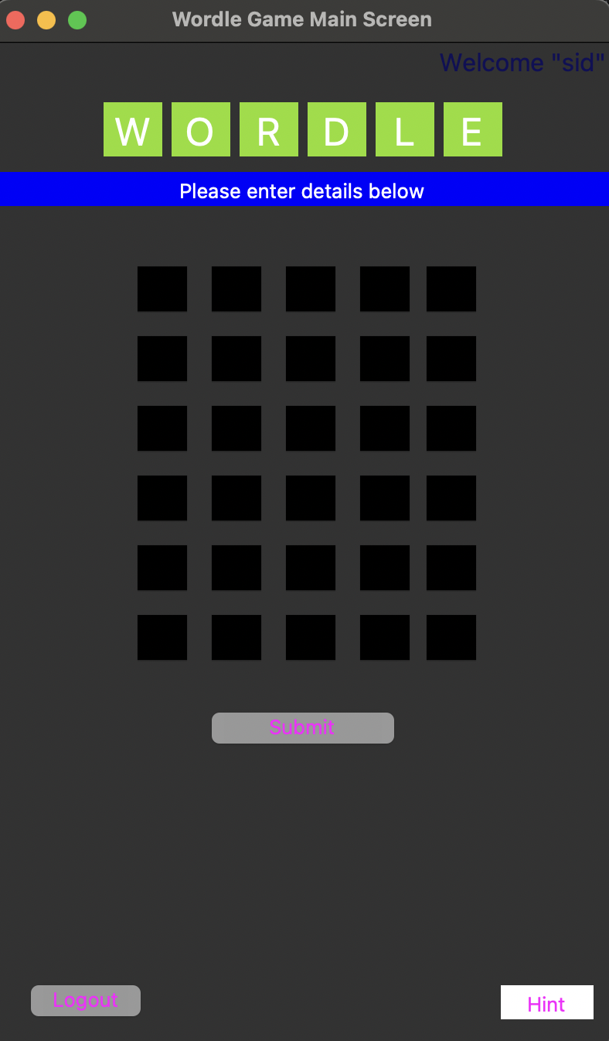
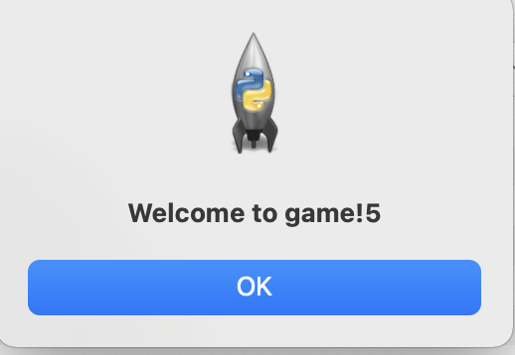
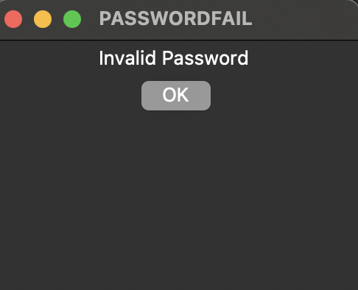
After successfully login
Username
Message after entering correct username and password
Main screen of the game
Error Message after invalid password or username

Slide 8
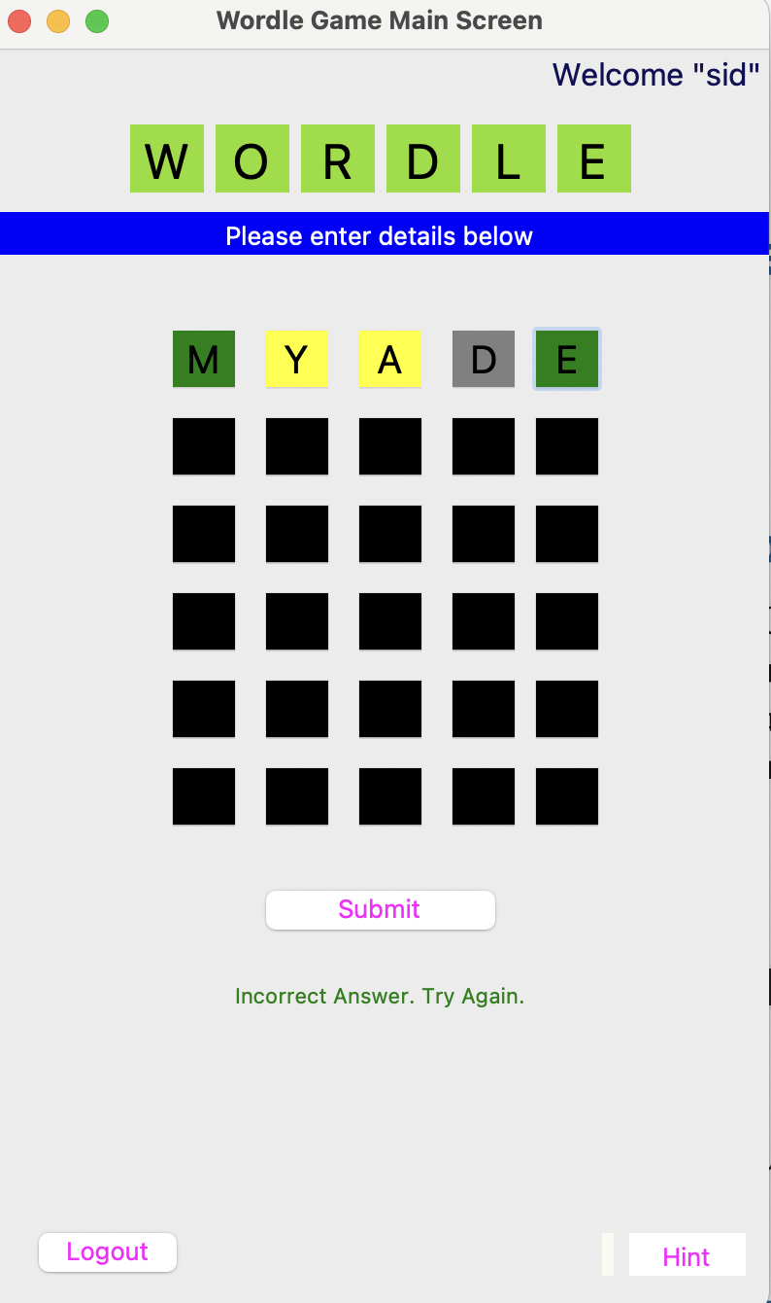
Green color indicates letter does exist in the word and is at correct position
Yellow color indicates letter exist in the word but at wrong position
Gray color indicates letter does not exist in the word

Slide 9
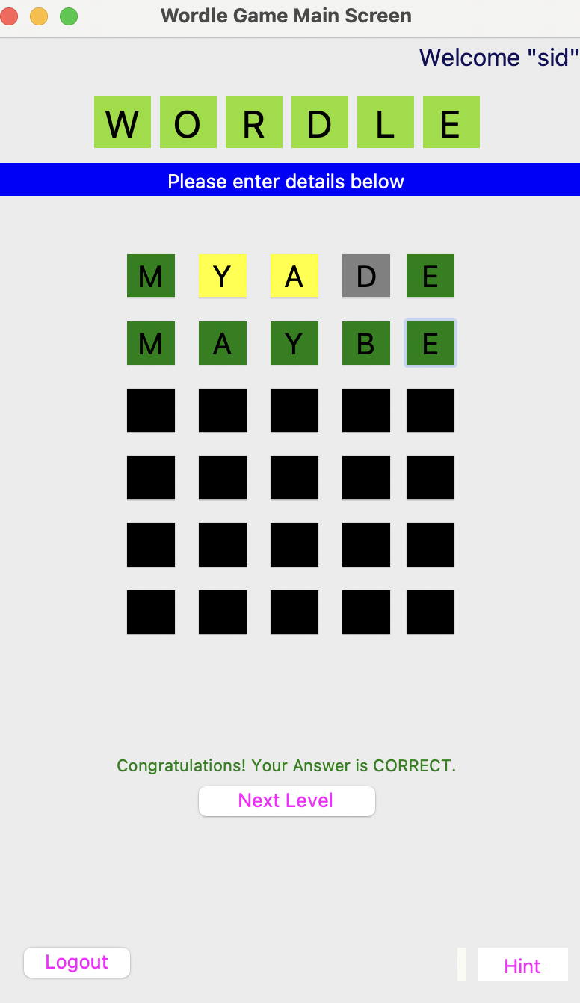
After successfully guessing the word
“Congratulation! Your Answer is correct.”message
will pop up.

Slide 10
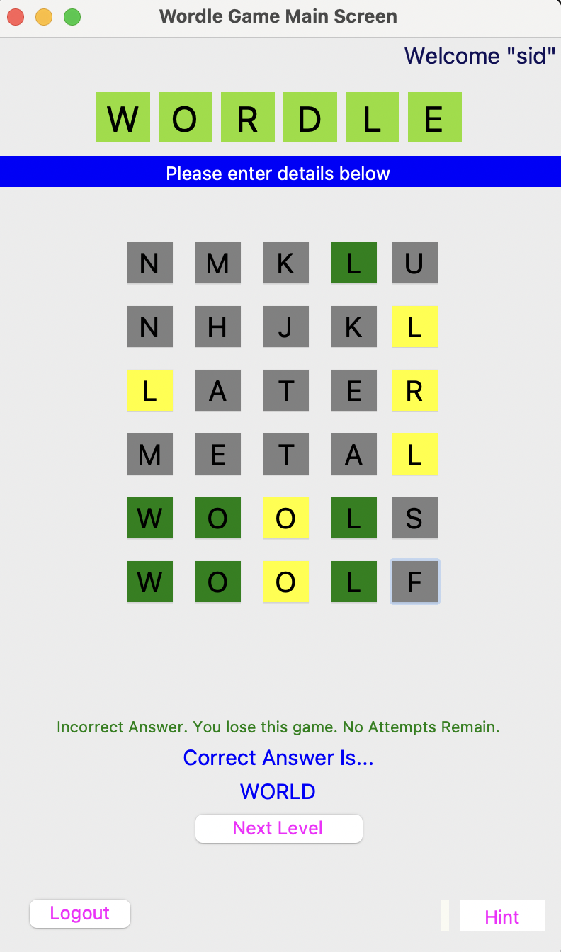
If you are unable to guess the word in six attempts
“Incorrect Answer: You lose this game.No attempts
Remain” message will pop up.
It will also display what was the correct answer/word.
You can select Next Level to play again new word.

Slide 11
Object-Oriented Programming Concept
Let’s go through this concept

Slide 12
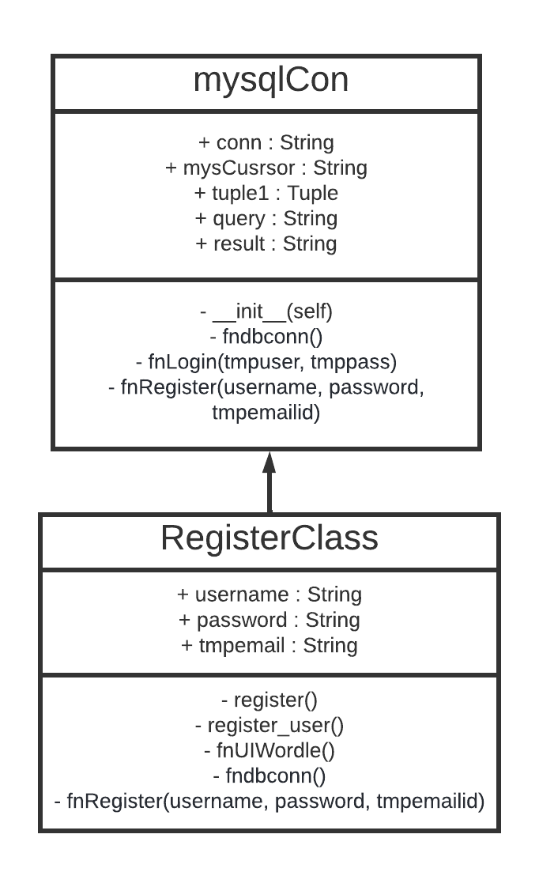
Single Level Inheritance:
Base Class
class mysqlCon:
def fndbconn(self):
global conn
import mysql.connector as mysqlConnector
conn = mysqlConnector.connect(
host='localhost', user='root', password='Sagar@2602',database='PythonWordle')
...
def fnRegister(username, password, tmpemailid):
...
Derived Class
class RegisterClass(mysqlCon):
def register_user(self): #Implementing event on register button.
self.fndbconn() #Calling fndbConn() from mysqlConn class using Inheritance.
...
# Designing window for registration
def register(self):
global register_screen
...
# This line is to add style to button texts.
Button(register_screen, text="Register", font="buttonFont", width=10,
height=1, bg="blue", fg="magenta", command=lambda: self.register_user()).pack()
As you can see, we have used two
Methods from Base(Parent) Class.

Slide 13
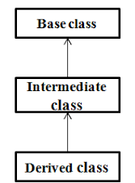
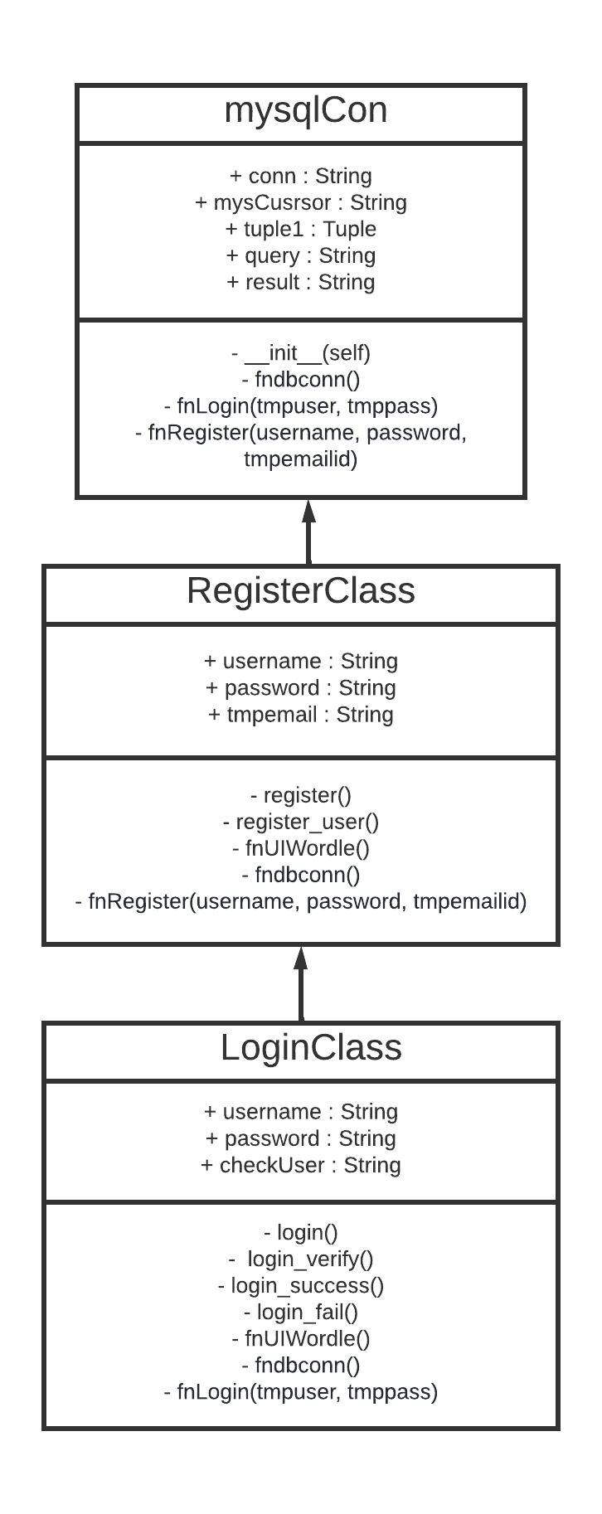
Multi-Level Inheritance:
Base Class
class mysqlCon:
def fndbconn(self):
global conn
import mysql.connector as mysqlConnector
...
def fnLogin(self, tmpuser, tmppass):
...
Intermediate Class
class RegisterClass(mysqlCon):
def fnUIWordle(self):
L2 = Label(self.topframe, text="O", font=("Apple, 25"), bg="#8FDE21", width=2)
...
Derived Class
class LoginClass(RegisterClass):
def login(self):
...
self.fnUIWordle()
def login_verify(self):
...
self.fndbconn()
...
self.checkUser = self.fnLogin(self.username, self.password)
...
As you can see, now we can access Base Class methods by inheriting intermediate class and this concept called multi-level inheritance.

Slide 14
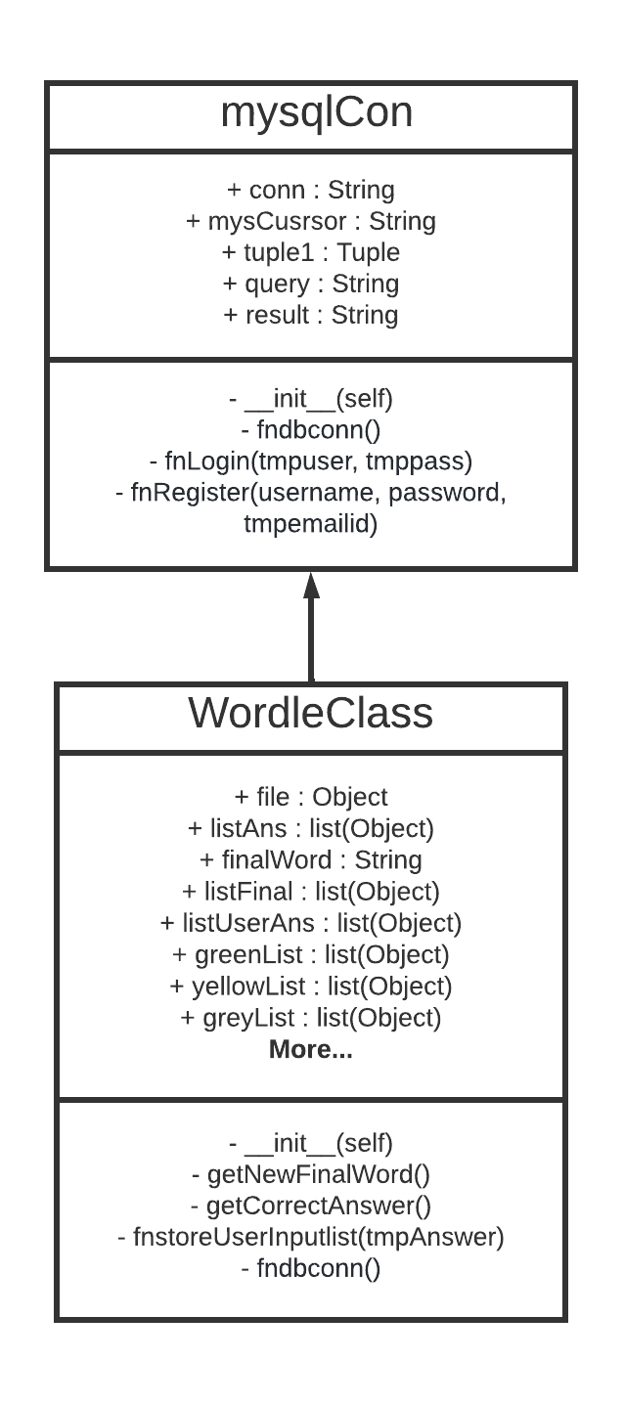
Single-Level Inheritance:
Base Class
class mysqlCon:
def fndbconn(self):
global conn
import mysql.connector as mysqlConnector
conn = mysqlConnector.connect(
host='localhost', user='root', password='Sagar@2602',database='PythonWordle')
...
Derived Class
class WordleClass(mysqlCon):
# Designing window for login.
def getNewFinalWord(self):
...
self.fndbConn()
As you can see, we have used two
Methods from Base(Parent) Class.

Slide 15
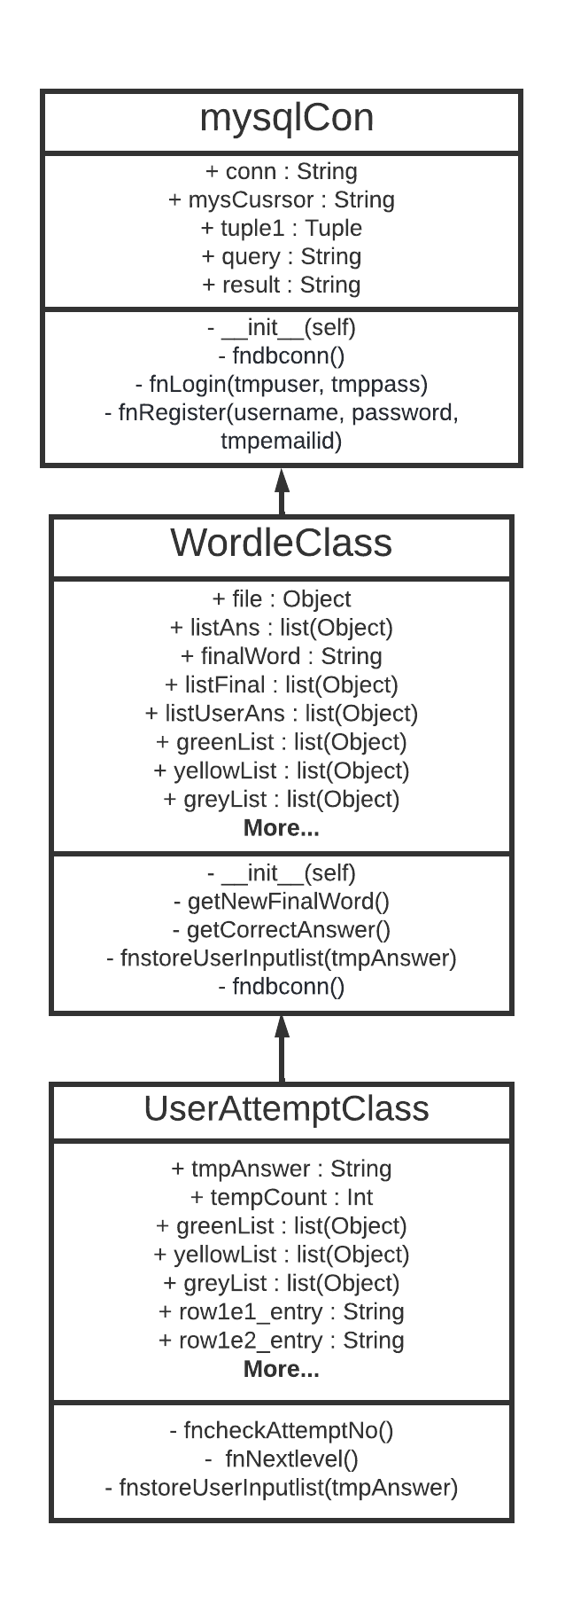
Multi-Level Inheritance:
Base Class
class mysqlCon:
def fndbconn(self):
global conn
import mysql.connector as mysqlConnector
conn = mysqlConnector.connect(
host='localhost', user='root', password='Sagar@2602',database='PythonWordle')
...
Intermediate Class
class WordleClass(mysqlCon):
# Designing window for login.
def getNewFinalWord(self):
...
self.fndbConn()
Derived Class
class UserAttemptClass(WordleClass):
def fnCheckAttemptNo(self):
# Using global variables to access in this function.
...
greenList, yellowList, greyList = self.fnStoreUserInputList(
tmpAnswer.upper())
...
As you can see, we have accessed Base Class methods in intermediate class and then used intermediate class method to the derived class. This concept called multi-level inheritance.

Slide 16
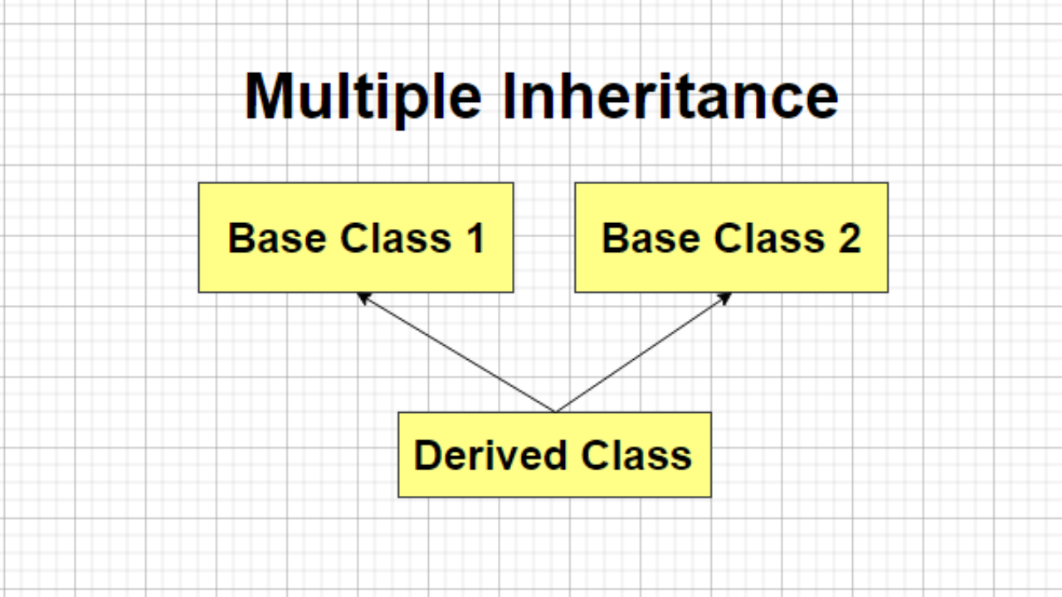
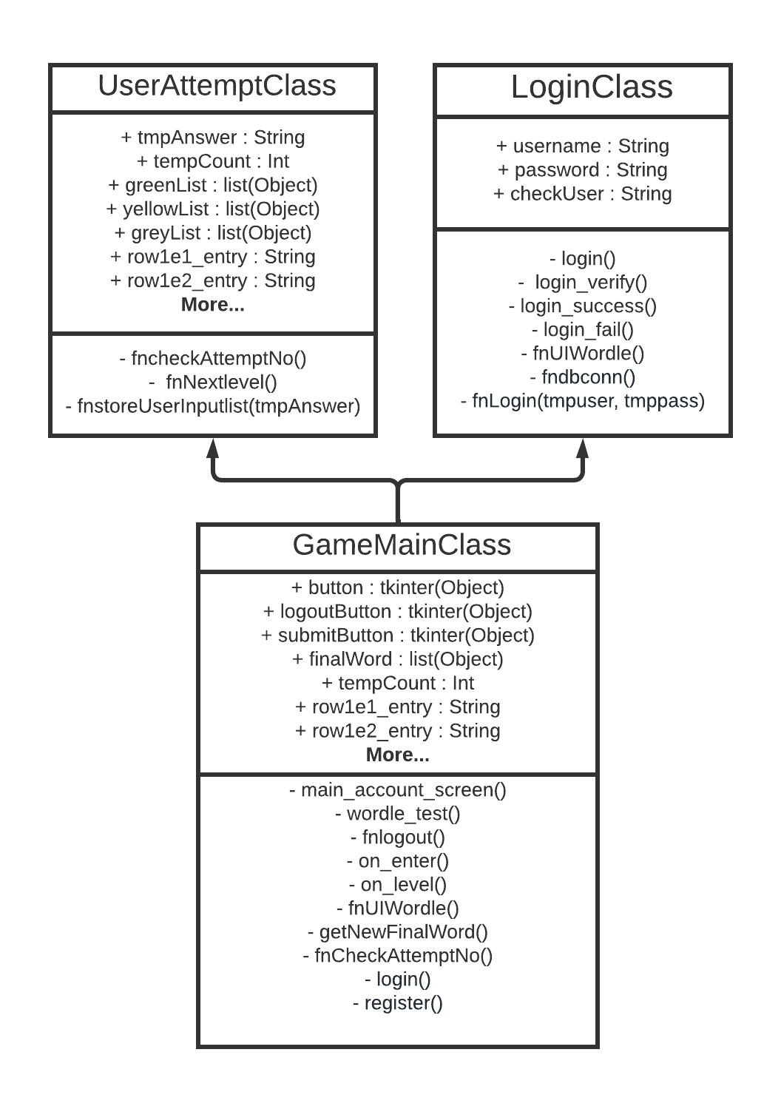
Multiple Inheritance:
Base Class-1
class UserAttemptClass(WordleClass):
def fnCheckAttemptNo(self):
...
Base Class-2
class LoginClass(RegisterClass):
# Designing window for login.
def login(self):
...
Derived Class
class GameMainClass(LoginClass, UserAttemptClass):
# Designing Main(first) window
def main_account_screen(self):
...
Button(text="Login", command=lambda:self.login()).pack()
...
button = Button(text="Register", command=lambda: self.register()).pack()
...
def wordle_test(self):
self.fnUIWordle() #Calling method of RegisterClass.
...
self.finalWord = self.getNewFinalWord()
submitButton.pack(pady=20)
submitButton.config(command=self.fnCheckAttemptNo)
...
Here, Total five methods are used from another classes by using Inheritance.
1. login() - LoginClass
2. register() - RegisterClass()
3. fnUIWordle() - RegisterClass
4. getNewFinalWord() - WordleClass
5. fnCheckAttempNo() - UserAttemptClass

Slide 17
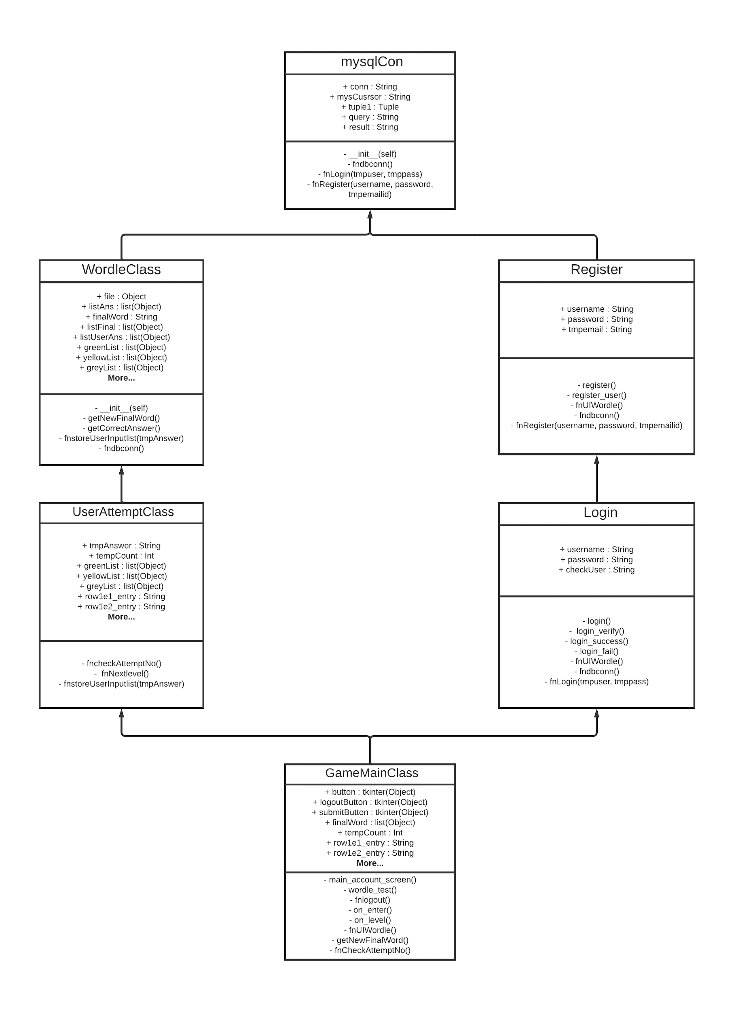
Class Diagram

Slide 18
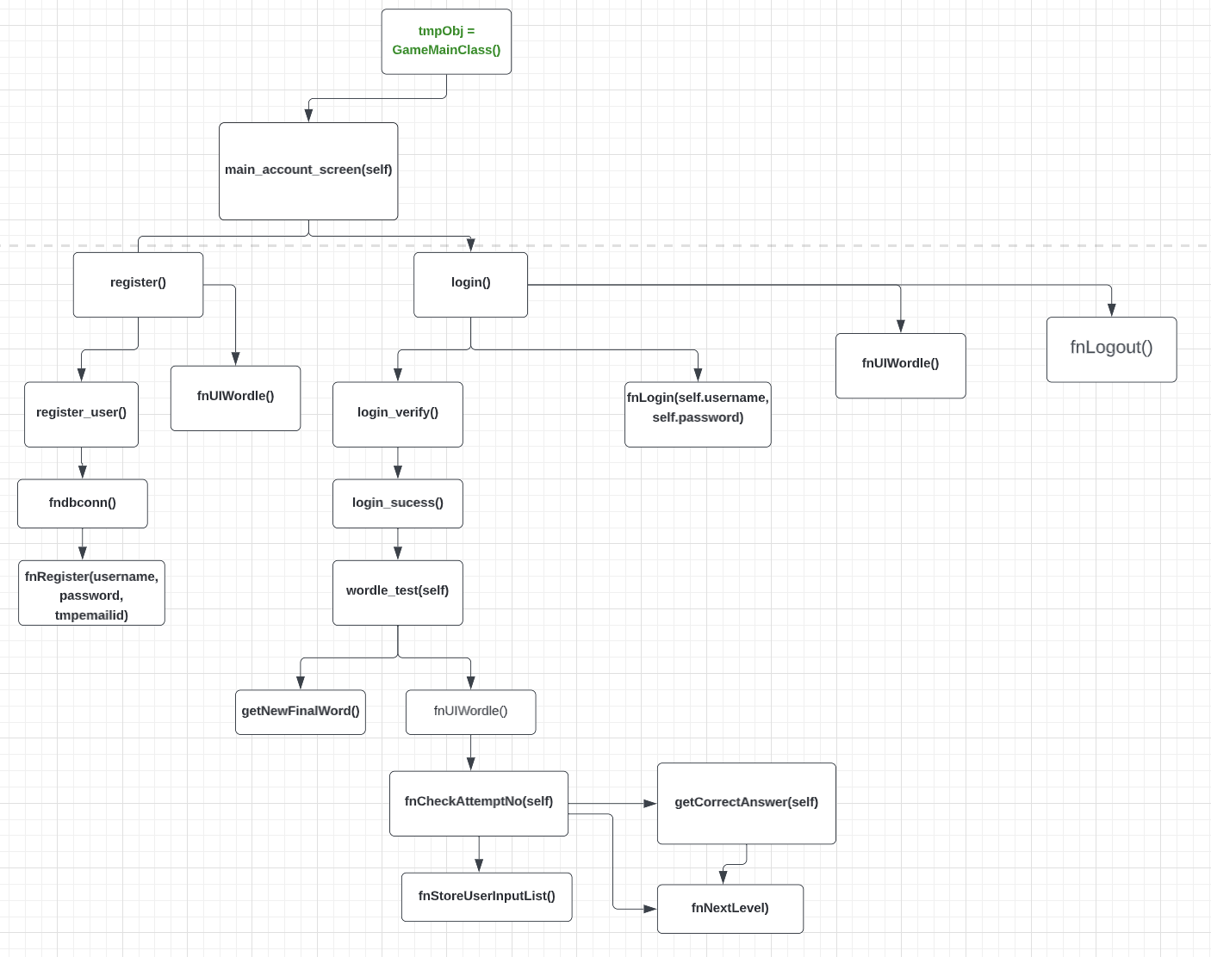
FUNCTION STRUCTURE CHART

Slide 19
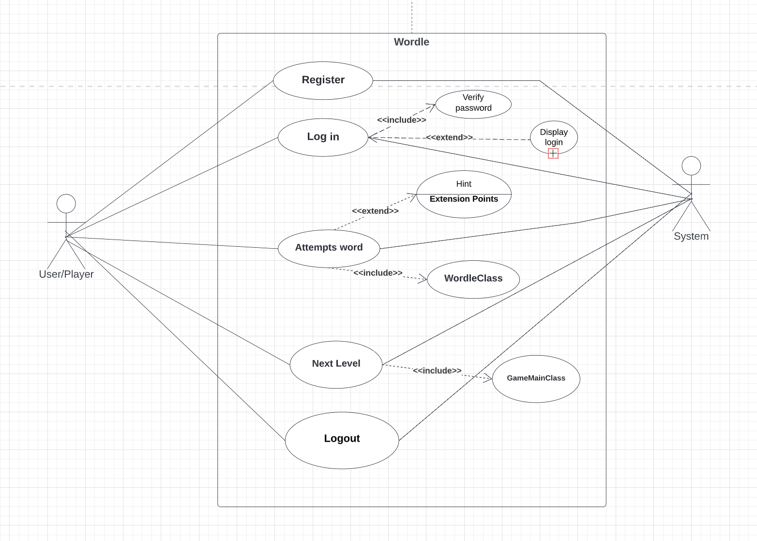
Use case diagram

Slide 20
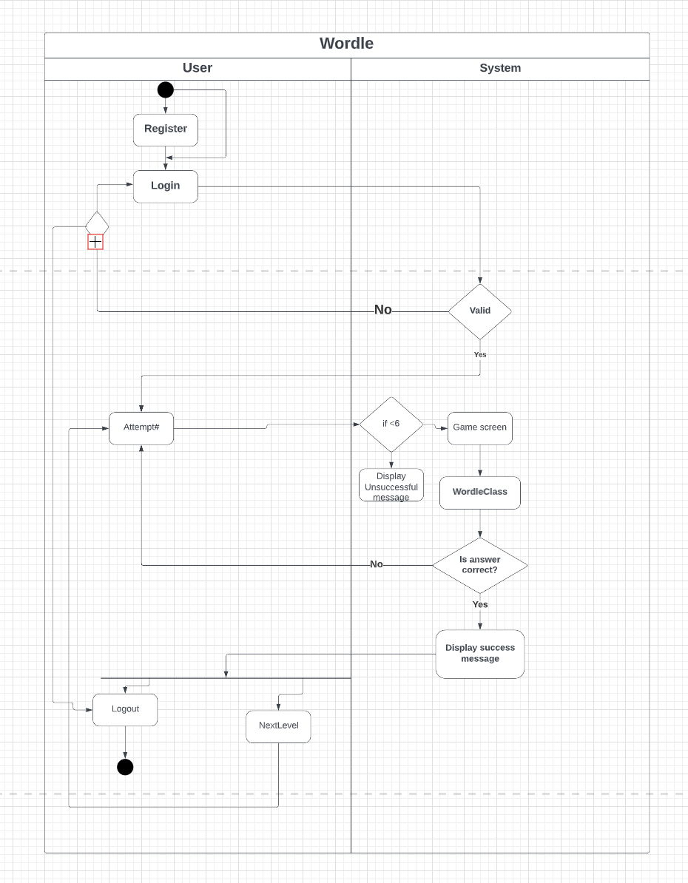
Activity Diagram:

Slide 21
Let’s dive into Logic of the game…….

Slide 22
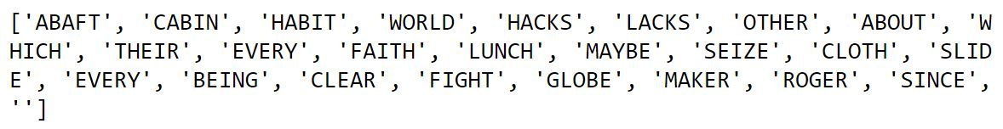
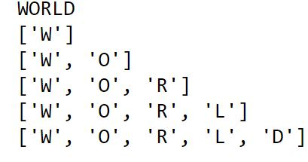
Class WordleClass:
def getNewFinalWord(): # output- listAns
listAns=[]
file=open(“wordle.txt”,”r”)
str=file.read().split(‘\n’)
listAns=str
file.close()
print(listAns)
# Generating random word for today's game
tmpRandomChoice= random.randrange(0,26)
#This is to store random generated word for game #output- finalWord
i=1
finalWord=listAns[tmpRandomChoice]
listFinal=[]
listFinal.clear()
for i in range(5):
listFinal.append(finalWord[i])
print(listFinal)
return finalWord
#this is the final word for today's game WORLD

Slide 23
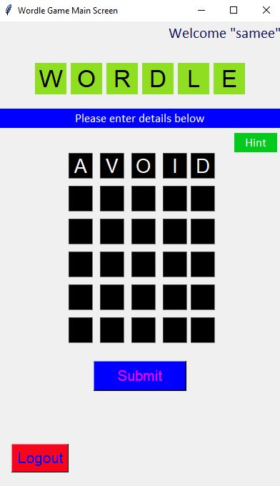
def fnCheckAttemptNo():
if tempCount==1:
row1e1_info=row1e1_entry.get()
row1e2_info=row1e2_entry.get()
row1e3_info=row1e3_entry.get()
row1e4_info=row1e4_entry.get()
row1e5_info=row1e5_entry.get()
row1e1_entry.config(state=’disabled’)
row1e2_entry.config(state=’disabled’)
row1e3_entry.config(state=’disabled’)
row1e4_entry.config(state=’disabled’)
row1e5_entry.config(state=’disabled’)
tmpAnswer=row1e1_info+row1e2_info_rowe3_info+row1e4_info_row1e5_info
print(f”tmpanswer={tmpAnswer}”)
greenList,yellowList,greyList=WordleClass.fnStoreUserInputList(tmpAnswer)

Slide 24
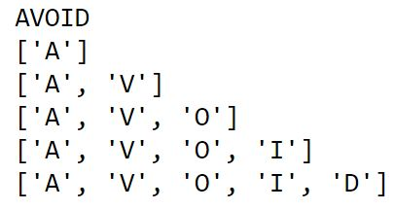
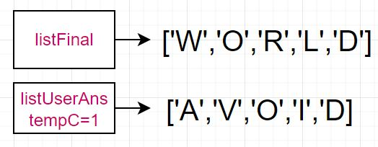
def fnStoreUserInputList(tmpAnswer): #tempCount1_Row1=listUserAns
listUserAns=[]
listUserAns.clear()
j=1
for j in range(5):
listUserAns.append(tmpAnswer[j])
print(listUserAns)

Slide 25
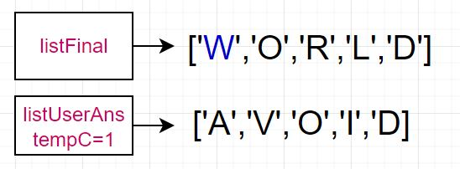
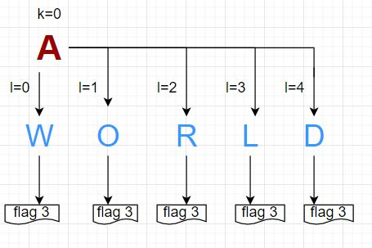
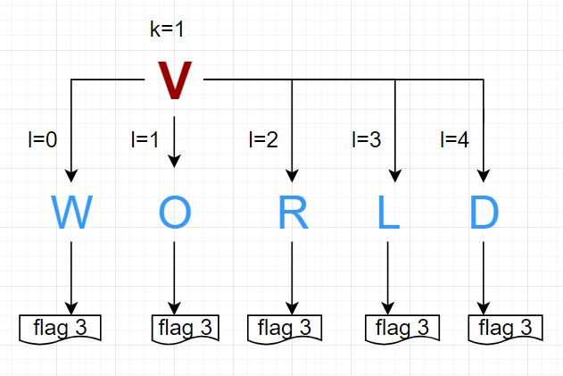
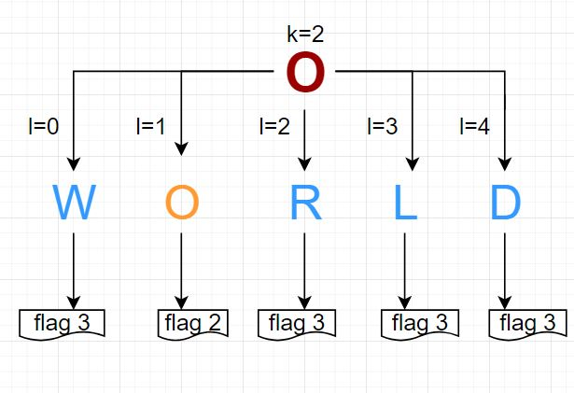
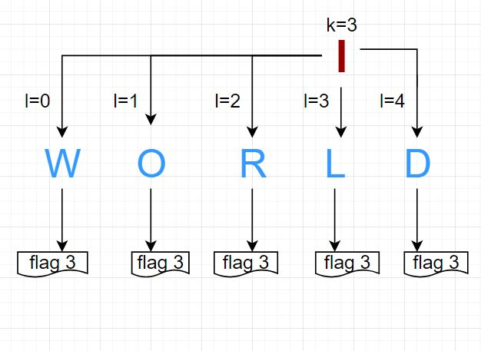
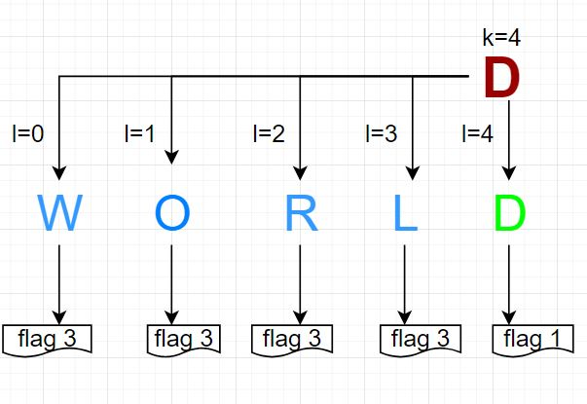
k=0
l=0
#Matching user answer and final answer
for k in range(5):
print(f"\nChecking result for the #{k+1} letter.")
flag1=0
flag2=0
flag3=0
for l in range(5):
user=listUserAns[k]
computer=listFinal[l]
#user==computer is used for letter matching, k==l is used for position matching.
if user==computer and k==l:
flag1=1
elif user==computer and k!=l:
flag2=2
elif user!==computer:
flag3=3
else:
print("")

Slide 26
if flag1==1: #flag3==3
#print(f"Position of letter #{user} is correct.") #greenList [5]
print(f"\033[1;32;40m {user} \n")
greenList.append(k+1)
elif flag2==2 and flag3==3:
#print(f"This #{user} letter is exist but position is not correct.")#yellowlist[3] #flag3==3
print(f"\033[1;33;40m {user} \n")
yellowList.append(k+1)
elif flag3==3:
#print(f"This #{user} letter is not exist.") #grey list [1,2,4] #flag2==2
print(f"\033[1;37;40m {user} \n")
greyList.append(k+1)
else:
print("")
return greenList,yellowList,greyList
#flag3==3
#greenList [5]
#yellowList [3]
#greyList [1,2,4]
#flag1==1

Slide 27
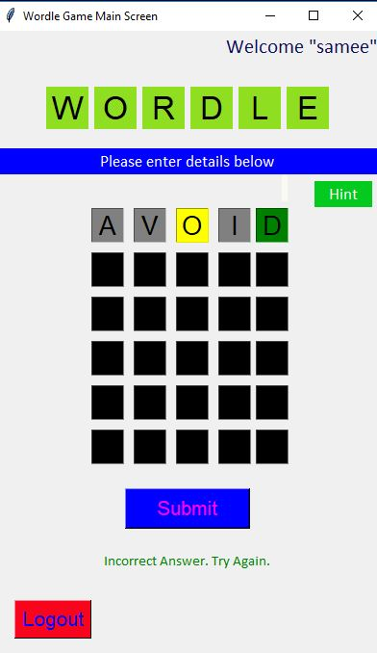
for i in greenList:
if i == 1:
row1e1_entry.configure(disabledbackground="green", state="disabled", disabledforeground="black")
if i == 2:
row1e2_entry.configure(disabledbackground="green", state="disabled", disabledforeground="black")
if i == 3:
row1e3_entry.configure(disabledbackground="green", state="disabled", disabledforeground="black")
if i == 4:
row1e4_entry.configure(disabledbackground="green", state="disabled", disabledforeground="black")
if i == 5:
row1e5_entry.configure(disabledbackground="green", state="disabled", disabledforeground="black")
for i in yellowList:
if i == 1:
row1e1_entry.configure(disabledbackground="yellow", state="disabled", disabledforeground="black")
if i == 2:
row1e2_entry.configure(disabledbackground="yellow", state="disabled", disabledforeground="black")
if i == 3:
row1e3_entry.configure(disabledbackground="yellow", state="disabled", disabledforeground="black")
if i == 4:
row1e4_entry.configure(disabledbackground="yellow", state="disabled", disabledforeground="black")
if i == 5:
row1e5_entry.configure(disabledbackground="yellow", state="disabled", disabledforeground="black")
for i in greyList:
if i == 1:
row1e1_entry.configure(disabledbackground="grey", state="disabled", disabledforeground="black")
if i == 2:
row1e2_entry.configure(disabledbackground="grey", state="disabled", disabledforeground="black") #greenList[5]
if i == 3:
row1e3_entry.configure(disabledbackground="grey", state="disabled", disabledforeground="black") #yellowList[3]
if i == 4:
row1e4_entry.configure(disabledbackground="grey", state="disabled", disabledforeground="black") #greyList[1,2,4]
if i == 5:
row1e5_entry.configure(disabledbackground="grey", state="disabled", disabledforeground="black")

Slide 28
# Checking if answer is correct or not.
if len(greenList) == 5: #greenList[5]
tmpLabelcorrect = Label( wordle_screen, text="Congratulations! Your Answer is CORRECT.",
fg="green",font=("calibri", 11))
tmpLabelcorrect.pack()
else:
tmpLabel = Label(wordle_screen, text="Incorrect Answer. Try Again."
, fg="green", font=("calibri", 11))
tmpLabel.pack()
tempCount += 1
#greenList [5]
#yellowList [2]
#greyList [1,3,4]

Slide 29
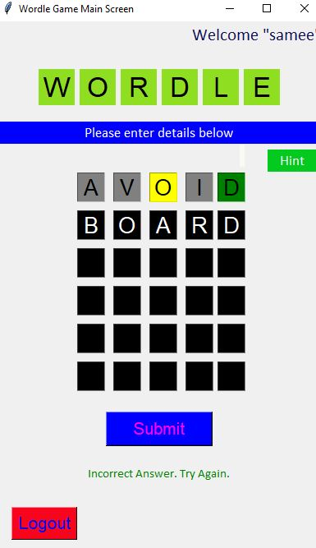
def fnCheckAttemptNo()
If tempCount==2:
row2e1_info=row2e1_entry.get()
row2e2_info=row2e2_entry.get()
row2e3_info=row2e3_entry.get()
row2e4_info=row2e4_entry.get()
row2e5_info=row2e5_entry.get()
row2e1_entry.config(state=’disabled’)
row2e2_entry.config(state=’disabled’)
row2e3_entry.config(state=’disabled’)
row2e4_entry.config(state=’disabled’)
row2e5_entry.config(state=’disabled’)
tmpAnswer=row2e1_info+row2e2_info_row2e3_info+row2e4_info_row2e5_info
print(f”tmpanswer={tmpAnswer}”)
greenList,yellowList,greyList=WordleClass.fnStoreUserInputList(tmpAnswer)

Slide 30
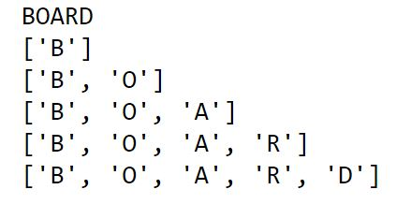
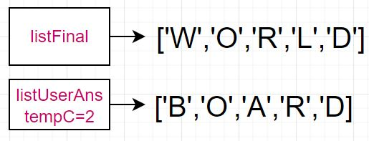
def fnStoreUserInputList(tmpAnswer): #tempCount2_Row2=listUserAns
listUserAns=[]
listUserAns.clear()
j=1
for j in range(5):
listUserAns.append(tmpAnswer[j])
print(listUserAns)

Slide 31
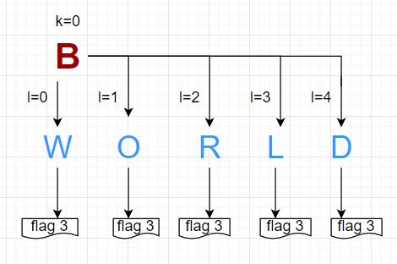
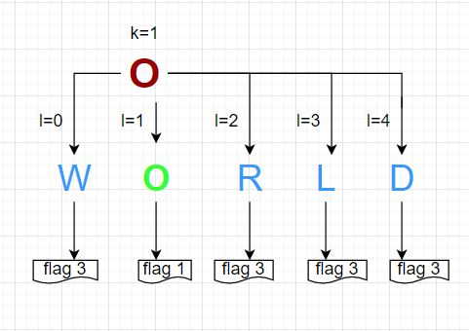
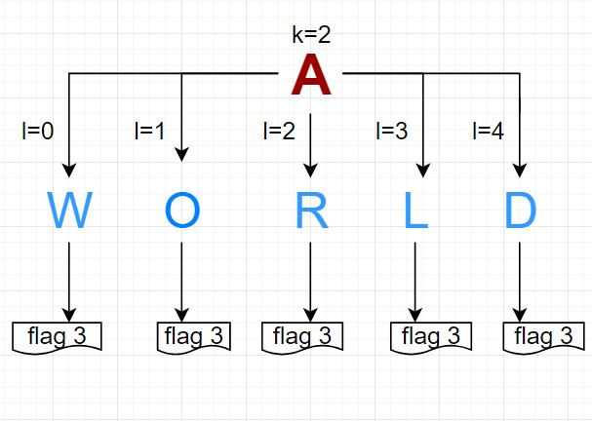
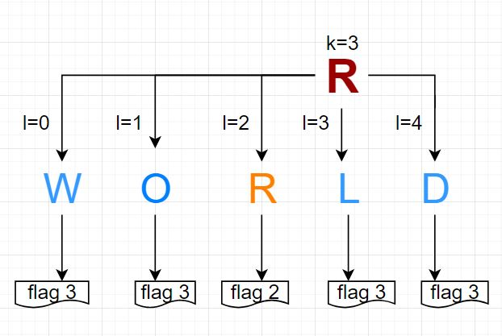
k=0
l=0
#Matching user answer and final answer
for k in range(5):
print(f"\nChecking result for the #{k+1} letter.")
flag1=0
flag2=0
flag3=0
for l in range(4):
user=listUserAns[k]
computer=listFinal[l]
if user==computer and k==l:
flag1=1
elif user==computer and k!=l:
flag2=2
elif user!=computer:
flag3=3
else:
print("")

Slide 32
if flag1==1 : #flag3==3
#print(f"Position of letter #{user} is correct.") #greenList [2,5]
print(f"\033[1;32;40m {user} \n")
greenList.append(k+1)
elif flag2==2 and flag3==3:
#print(f"This #{user} letter is exist but position is not correct.")#yellowlist[4]
print(f"\033[1;33;40m {user} \n") #flag1==1
yellowList.append(k+1)
elif flag3==3:
#print(f"This #{user} letter is not exist.") #greylist [1,3] #flag3==3
print(f"\033[1;37;40m {user} \n")
greyList.append(k+1)
else:
print("")
return greenList,yellowList,greyList #flag2==2
#greenList[2,5]
#yellowList [4]
#greyList [1,3]
#flag1==1

Slide 33
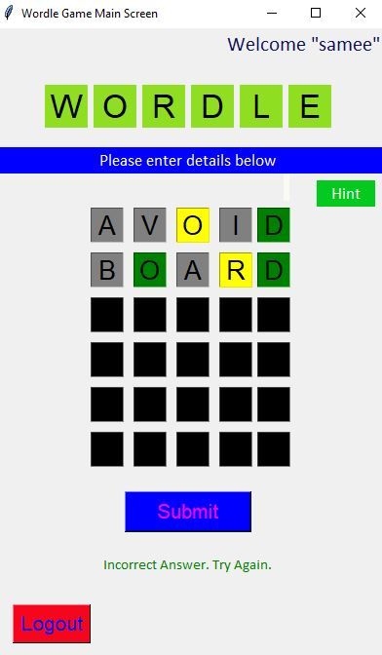
for i in greenList:
if i == 1:
row2e1_entry.configure(disabledbackground="green", state="disabled", disabledforeground="black")
if i == 2:
row2e2_entry.configure(disabledbackground="green", state="disabled", disabledforeground="black")
if i == 3:
row2e3_entry.configure(disabledbackground="green", state="disabled", disabledforeground="black")
if i == 4:
row2e4_entry.configure(disabledbackground="green", state="disabled", disabledforeground="black")
if i == 5:
row2e5_entry.configure(disabledbackground="green", state="disabled", disabledforeground="black")
for i in yellowList:
if i == 1:
row2e1_entry.configure(disabledbackground="yellow", state="disabled", disabledforeground="black")
if i == 2:
row2e2_entry.configure(disabledbackground="yellow", state="disabled", disabledforeground="black")
if i == 3:
row2e3_entry.configure(disabledbackground="yellow", state="disabled", disabledforeground="black")
if i == 4:
row2e4_entry.configure(disabledbackground="yellow", state="disabled", disabledforeground="black")
if i == 5:
row2e5_entry.configure(disabledbackground="yellow", state="disabled", disabledforeground="black")
for i in greyList:
if i == 1:
row2e1_entry.configure(disabledbackground="grey", state="disabled", disabledforeground="black")
if i == 2:
row2e2_entry.configure(disabledbackground="grey", state="disabled", disabledforeground="black") #greenList[2,5]
if i == 3:
row2e3_entry.configure(disabledbackground="grey", state="disabled", disabledforeground="black") #yellowList[4]
if i == 4:
row2e4_entry.configure(disabledbackground="grey", state="disabled", disabledforeground="black") #greyList[1,3]
if i == 5:
row2e5_entry.configure(disabledbackground="grey", state="disabled", disabledforeground="black")

Slide 34
# Checking if answer is correct or not.
if len(greenList) == 5: #greenList[2,5]
tmpLabelcorrect = Label( wordle_screen, text="Congratulations!
Your Answer is CORRECT.", fg="green",font=("calibri", 11))
tmpLabelcorrect.pack()
else:
tmpLabel = Label(wordle_screen, text="Incorrect Answer. Try Again.", fg="green",
font=("calibri", 11))
tmpLabel.pack()
tempCount += 1
#tempcount=tempcount+1=2+1=3
#greenList [2,5]
#yellowList [4]
#greyList [1,3]

Slide 35
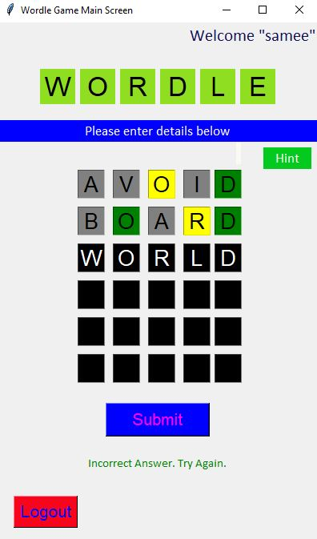
def fnCheckAttemptNo()
If tempCount==3:
row3e1_info=row3e1_entry.get()
row3e2_info=row3e2_entry.get()
row3e3_info=row3e3_entry.get()
row3e4_info=row3e4_entry.get()
row3e5_info=row3e5_entry.get()
row3e1_entry.config(state=’disabled’)
row3e2_entry.config(state=’disabled’)
row3e3_entry.config(state=’disabled’)
row3e4_entry.config(state=’disabled’)
row3e5_entry.config(state=’disabled’)
tmpAnswer=row3e1_info+row3e2_info+row3e3_info+row3e4_info_row3e5_info
print(f”tmpanswer={tmpAnswer}”)
greenList,yellowList,greyList=WordleClass.fnStoreUserInputList(tmpAnswer)

Slide 36
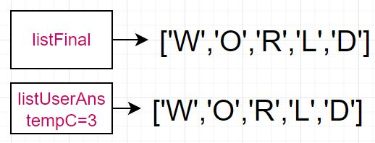
def fnStoreUserInputList(tmpAnswer): #tempCount3_Row3=listUserAns
listUserAns=[]
listUserAns.clear()
j=1
for j in range(5):
listUserAns.append(tmpAnswer[j])
print(listUserAns)

Slide 37
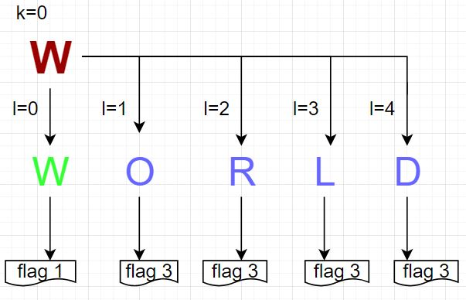
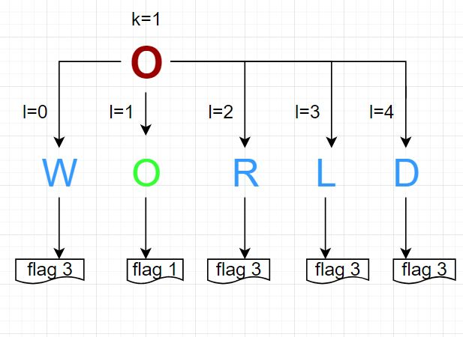
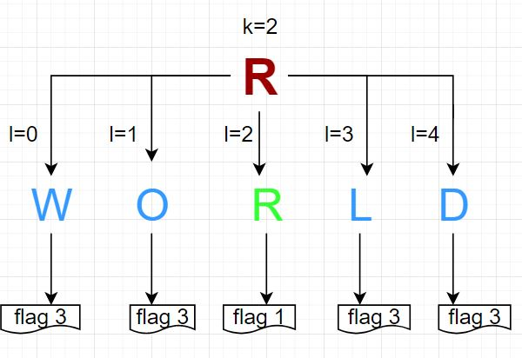
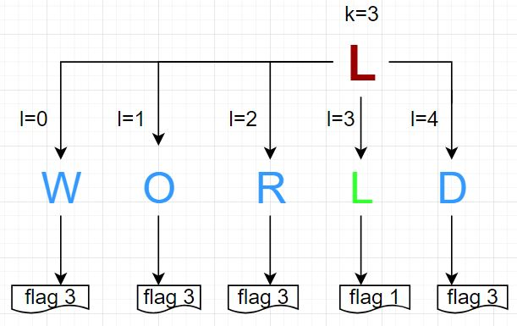
k=0
l=0
#Matching user answer and final answer
for k in range(5):
print(f"\nChecking result for the #{k+1} letter.")
flag1=0
flag2=0
flag3=0
for l in range(4):
user=listUserAns[k]
computer=listFinal[l]
if user==computer and k==l:
flag1=1
elif user==computer and k!=l:
flag2=2
elif user!=computer:
flag3=3
else:
print("")

Slide 38
if flag1==1 : #flag1==1
#print(f"Position of letter #{user} is correct.") #greenList [1,2,3,4,5]
print(f"\033[1;32;40m {user} \n")
greenList.append(k+1)
elif flag2==2 and flag3==3:
#print(f"This #{user} letter is exist but position is not correct.")#yellow list[]
print(f"\033[1;33;40m {user} \n") #flag1==1
yellowList.append(k+1)
elif flag3==3:
#print(f"This #{user} letter is not exist.") #grey list []
print(f"\033[1;37;40m {user} \n") #flag1==1
greyList.append(k+1)
else:
print("")
#flag1==1
return greenLIst,yellowLIst,greyLIst #flag1==1
#greenLIST [1,2,3,4,5]
#yellowList []
#greyList []
#flag1==1

Slide 39
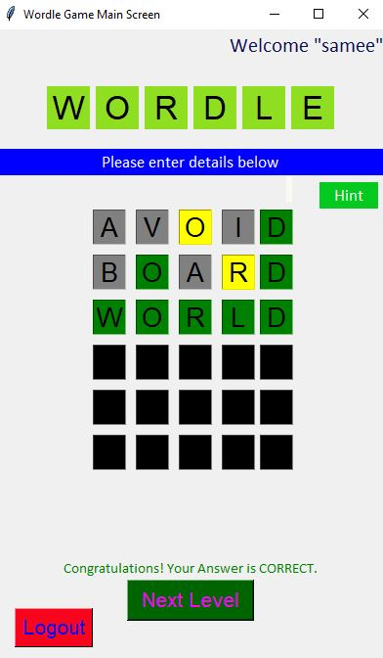
for i in greenList:
if i == 1:
row3e1_entry.configure(disabledbackground="green", state="disabled", disabledforeground="black")
if i == 2:
row3e2_entry.configure(disabledbackground="green", state="disabled", disabledforeground="black")
if i == 3:
row3e3_entry.configure(disabledbackground="green", state="disabled", disabledforeground="black")
if i == 4:
row3e4_entry.configure(disabledbackground="green", state="disabled", disabledforeground="black")
if i == 5:
row3e5_entry.configure(disabledbackground="green", state="disabled", disabledforeground="black")
for i in yellowList:
if i == 1:
row3e1_entry.configure(disabledbackground="yellow", state="disabled", disabledforeground="black")
if i == 2:
row3e2_entry.configure(disabledbackground="yellow", state="disabled", disabledforeground="black")
if i == 3:
row3e3_entry.configure(disabledbackground="yellow", state="disabled", disabledforeground="black")
if i == 4:
row3e4_entry.configure(disabledbackground="yellow", state="disabled", disabledforeground="black")
if i == 5:
row3e5_entry.configure(disabledbackground="yellow", state="disabled", disabledforeground="black")
for i in greyList:
if i == 1:
row3e1_entry.configure(disabledbackground="grey", state="disabled", disabledforeground="black")
if i == 2:
row3e2_entry.configure(disabledbackground="grey", state="disabled", disabledforeground="black") #greenList[1,2,3,4,5]
if i == 3:
row3e3_entry.configure(disabledbackground="grey", state="disabled", disabledforeground="black") #yellowList[]
if i == 4:
row3e4_entry.configure(disabledbackground="grey", state="disabled", disabledforeground="black") #greyList[]
if i == 5:
row3e5_entry.configure(disabledbackground="grey", state="disabled", disabledforeground="black")

Slide 40

# Checking if answer is correct or not.
if len(greenList) == 5: #greenList[1,2,3,4,5]
tmpLabelcorrect = Label( wordle_screen, text="Congratulations! Your Answer is CORRECT.", fg="green",font=("calibri", 11))
tmpLabelcorrect.pack()
else:
tmpLabel = Label(wordle_screen, text="Incorrect Answer. Try Again.",
fg="green", font=("calibri", 11))
tmpLabel.pack()
greenList[1,2,3,4,5]
yellowList[]
greyList=[]

Slide 41
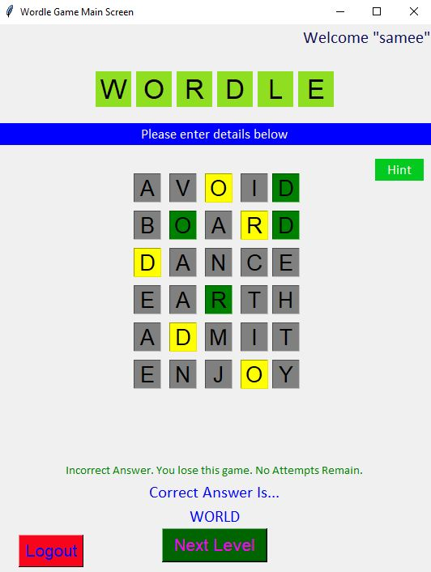

#if user loose the game after 6th attempt then final answer is displayed
def getCorrectAnswer():
print(f"Correct Answer = {finalWord}")
return finalWord
#After losing game the user can play again by clicking
Next Level button
btnNextLevel.config(command=fnNextLevel)
tempCount = 1
def fnNextLevel():
wordle_screen.destroy()
wordle_test()

Slide 42
Conclusion
The Wordle game is designed in python programming language and uses Object oriented programming and supporting packages and libraries. Using almost all kind of inheritance (single, multiple, multilevel and hybrid) developed a user friendly game.
Players had to make guesses in a minimum of attempts in order to keep the streak of winning. The system picks a brand daily word using random selection from the file. The very first attempt the player participates in is crucial. All the best!

Slide 43
Future scope
We can enhance our project to advanced level by the following measures:
The score panel can be added so that the game becomes competitive.
To fetch word from MySQL table instead of reading file.
We will also try to edit a game with a six letter word.
Reduce line of codes and add more functionality.

Slide 44
References:
https://www.mysql.com/
https://www.edureka.co/blog/tkinter-tutorial/
https://docs.python.org/3/library/ctypes.html
https://docs.python.org/3/library/cgitb.html
https://docs.python.org/3/library/os.html#

Slide 45
The End

